Slide 1
Corning Scope 3 Emission Program

Slide 2
Information security
This presentation contains Corning information and is intended solely for those with a need to know. It may not be distributed, in whole or part, in any form by any means, or by any person or organization without authorization from Corning Incorporated.
Notes:
This deck is for internal use only.

Slide 3




GHG 101: Scope 1 and 2
Speakers
Susan McNichols
Project Consultant WSP,
Sustainability Energy and Climate Change
Ojas Satham
Associate Consultant WSP,
Sustainability Energy and Climate Change
Adeola Adeusi
Project Manager,
Global Supply Management Corning Inc.

Slide 4

Planned Training Webinars
Training Topic | Webinar Date
Scopes 1&2 Accounting Training | May 4th
Scope 3 Accounting Training | May 11th
Setting a Science Based Target Training | May 18th
Renewable Energy Target and Procurement Training | May 25th
Product Carbon Footprint Training | May 26th
Suppliers that are requested to attend specific trainings based on maturity level will be notified by email. All trainings are optional for all suppliers.

Slide 5
Scope 1 and 2 GHG Accounting
Agenda
Webinar Objectives
Corning Overview and Supplier Expectations
Introduction to Greenhouse Gases
Next Steps and Resources
GHG Inventory Overview
GHG Calculation and CDP Reporting

Slide 6

Webinar Objectives
  Understand Corning’s updated supplier expectations
  Understand the process to develop a robust greenhouse gas inventory
  Understand how to calculate and report your organization’s Scope 1 and 2 emissions through CDP

Slide 7
Corning Scope 3 Emission Program
Adeola Adeusi

Slide 8
Our Approach
To Sustainability
At Corning, we take a long-term approach to sustainability,
as we address key challenges of the moment and evolve to meet the needs of the future.
We think about our contributions in two categories. One is
our footprint – how our actions directly affect others in
areas such as gender pay equity and carbon emissions from our operations. The other is our handprint – what we enable others to do through our products and services, such as helping to deliver over 8 billion COVID-19 vaccine doses
to date through our glass vials.
We prioritize areas where we have distinctive capabilities
to create value for our shareholders and meaningful progress for society. We also emphasize areas where our stakeholders are looking for us to set an example – areas such as supporting human rights in our supply chain, advancing gender equity, and acting with integrity in all we do.
Investing in these areas also makes us more resilient and supports our ability to do what we do best – innovate.
“Quite simply, we’ve succeeded over the long term by always working to become better versions of ourselves. We never lose sight of our purpose, our Values, and the importance of engaging with – and delivering for – key stakeholders. And that’s “our why” – we always seek to advance and apply our leadership capabilities to make a positive difference in the world.”
Wendell P. Weeks
Chairman and Chief Executive Officer

Slide 9








2023 Corning Sustainability Goals
Reduce our absolute Scope 1 and 2 greenhouse gas (GHG) emissions 30% by 2028 from a 2021 base year
Reduce our absolute Scope 3 GHG emissions, covering purchased goods and services, capital goods, fuel- and energy-related activities, and upstream transportation and distribution 17.5% by 2028 from a 2021 base year
Increase our use of renewable energy by 400% by 2030 from a 2018 baseline
By the end of 2023, assess Corning’s exposure to water stress
By the end of 2024, Corning will be generating monthly, accurate, and comprehensive water use data for our top 10 water-use facilities
By the end of 2028, Corning will increase its waste diversion rate to greater than 80% globally
New!
By the end of 2023, Corning will be generating monthly, accurate, and comprehensive landfill waste and diverted waste data for our top 10 waste-generating sites
Certify 100% of our high-risk suppliers as socially responsible by 2025
Reduce our total recordable case incident rate (TRIR) within the portion of our operations that disproportionately contribute to our overall recordable injury and illness rate by at least 10%
Encourage increased volunteerism efforts year over year by supporting, rewarding, and recognizing employees’ efforts in the community
Achieve understanding of the Corning Code of Conduct, including how to report allegations of ethical or legal misconduct, among 100% of employees
New!
New!
New!
New!

Slide 10
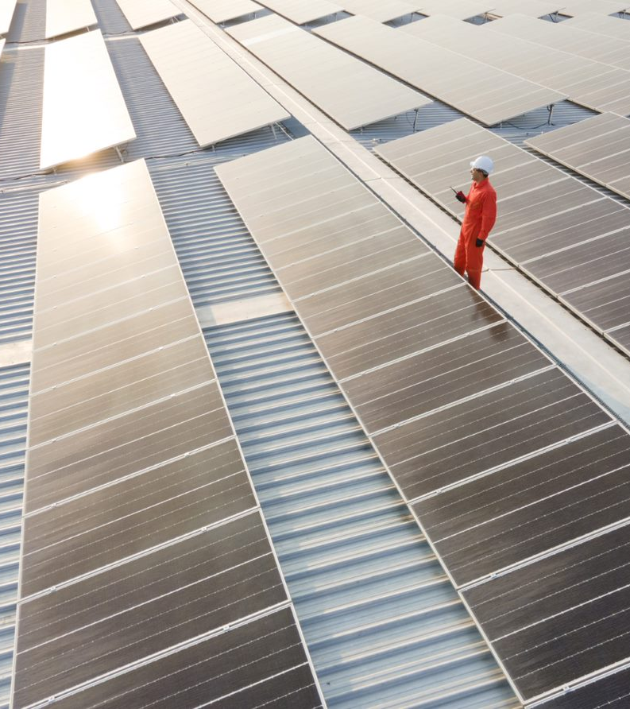
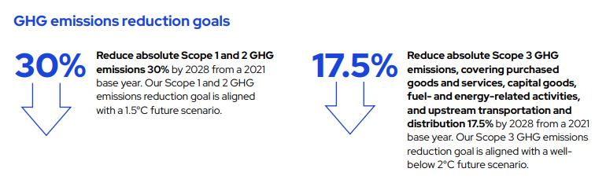
Greenhouse Gas (GHG) Emissions Reduction Goals
In 2022, Corning submitted targets for validation to the Science Based Targets initiative (SBTi), underscoring our commitment to set near-term company-wide emission reductions in line with Climate science, and aligning with the goals of the Paris Agreement.

Slide 11
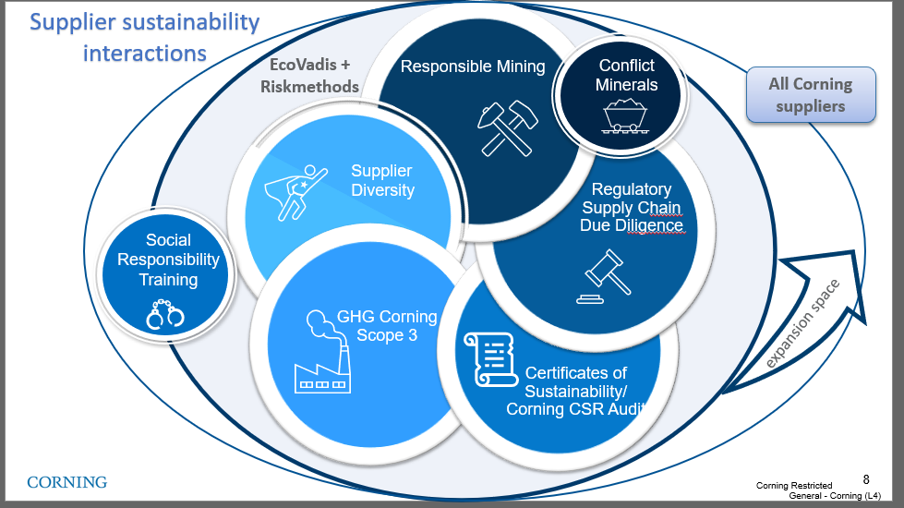
Climate Change is part of GSM's sustainability strategy
Our management of
Sustainable Supply Chain
Working with our suppliers globally, with a focus on Corporate Social Responsibility (CSR) and Climate Change Issues reduces our supply disruption risk and exposure to regulatory and reputational risk.
Our aim is to establish standardized, verified information-based management process contributing to Corning's long-term commitment on sustainable supply.
Supply Chain Sustainability Strategy
Scope 3 program
Last update Jan 2023
Notes:
CO₂ – Carbon dioxide
CH₄ – Methane
N₂O – Nitrous oxide (laughing gas)
HFC_{s} – Hydrofluorocarbons (refrigeration units, fire extinguishers, aerosols….)
PFC_{s} – Perfluorochemicals (heat, oil, water, etc., resistant coatings – think cookware, carpet stain prevention for regular people lives) mess up the endocrine activity, reduce immune function etc..
SF₆ – Sulfur hexafluoride – circuit breakers, arc suppressant , electrical insulator, semiconductor manufacturing, and the production of magnesium. One of the more potent GHG’s – it only takes a small amount to do significant damage. Used in the manufacturing as well as maintenance of grid equipment. One mitigation tactic is to regularly check equipment quality for leaks , training on employees how to maintain and service WHILE new options are being discovered.

Slide 12
2023 supplier engagement goals defined and set for deployment
Program
Deployment
Active Engagement
Emission Reduction Plan
Communicate supplier
engagement program to the suppliers that contribute 80% of Corning/Hemlock scope 3 emissions.
(PG&S, Capital Goods, Transportation)
Develop and implement emission reduction plans with supplier classified as engaged leaders in the scope emissions program
Actively engage and train the suppliers that contribute 60% of emissions in PG&S,CAP category and 80% in the Transportation
Corning approved channel
CDP supply chain program

Slide 13
2023 Supplier Activities for Scope 3 Emission
1
1
Register/ Sign up for CDP
If you company did not disclosure through CDP in 2022, please register your account.
2
Attend Trainings
2
GHG emission topics hosted by Corning/WSP
3
Calculate Emission data
3
Disclose scope 1, 2 and 3 greenhouse gas (GHG) emissions data. Provide independent or third-party assurance of disclosed emissions
4
  Submit data and Allocate emission
4
Submit data through CDP. Deadline July 26th
5
  Reduce Emissions
Adopt a science-based (SBTi-approved) emissions reduction target
Set a renewable energy target and water management goal
5

Slide 14

Partnership is Critical
Collaboration with suppliers will be key to enabling Corning to achieve our Scope 3 emissions reduction goal.
Working with Suppliers to Reduce Upstream Emissions
Together with our partners, Corning will continue to reduce global GHG emissions aligned with our commitment to climate action.
Corning will be rolling out our formal supplier engagement program in 2023 to reduce upstream emissions from suppliers systematically
Corning’s new product innovations are increasingly focused on reducing embodied carbon in our products and our customers’ products and operations.
Integrating Sustainability into Our Innovation Process
Corning has begun to use life cycle assessments performed by third parties to provide industry-recognized calculations of embodied carbon and we will request additional LCA information from suppliers through our supplier engagement program.
We are also developing GHG-impact estimates to be used in the early-stage design of products.

Slide 15

Corning Scope 3 Supplier Expectations
Suppliers engaged starting in 2023 are expected to adhere to these requirements by 2026:
Disclose scope 1, 2 and 3 greenhouse gas (GHG) emissions data through CDP Supply Chain
Provide independent or third-party assurance of disclosed emissions
Adopt a science-based (SBTi-approved) emissions reduction target
Set a renewable energy target
Respond to CDP Water Questionnaire
Set a water management goal

Slide 16
Introduction to Greenhouse Gases
Susan McNichols

Slide 17

What are Greenhouse gases?
Greenhouse gases trap heat from the sun and warm the planet's surface
Primary anthropogenic sources of GHG emissions are the burning of fossil fuels for electricity, heat and transportation – sources include combustion of gasoline & diesel for transportation, physical or chemical processing needed to produce goods from raw materials
The main three types of greenhouse gases are : CO₂, CH₄, N₂O.
  Other types are SF₆, NF₆, HFCs, NFCs

Slide 18
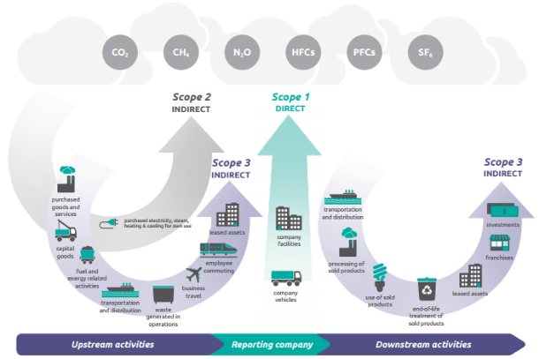
Operational Boundary: Scopes 1 , 2 & 3
GHG emissions are organized into categories, or “scopes”:
  Scope 1: direct emissions from fuel combustion and refrigerant leakage from company facilities and vehicles
  Scope 2: indirect emissions from the purchase of electricity, steam, heat, and cooling
  Scope 3: indirect emissions from a company’s value chain (e.g., purchased goods and services, use of sold products)
Source: Greenhouse Gas Protocol Corporate Value Chain (Scope 3) Accounting and Reporting Standard - page 7

Slide 19
GHG Inventory Overview
Susan McNichols

Slide 20
Poll the Audience
GHG Accounting 101: Scope 1 and 2
Has your company calculated Scope 1 and 2 GHG emissions before?
  Please type your answer into the chat box

Slide 21
GHG Inventory Steps
1. Scope
and Plan
2. Collect
Data
3. Review and Estimate Data
4. Finalize
and Report
5. Target Setting
  Review GHG accounting standards and methods for company reporting
  Determine boundaries - organizational and operational
  Identify data requirements and preferred methods for data collection
  Develop data collection procedures, tools, and guidance materials
  Compile facility data
  Review facility-level data and resolve potential issues
  Estimate missing data to fill gaps
  Calculate GHG emissions
  Finalize data
  Formalize data collection procedures
  Complete third-party verification (optional)
  Report requested data

Slide 22
Sources of GHG Emissions by Scope
Scope 1 | Scope 2 | Scope 3 – Upstream | Scope 3 – Downstream
Fuels used in operations Natural gas Fuel oil Diesel Gasoline Propane Refrigerants and process gases Mobile fuels used in vehicles Gasoline Diesel Biodiesel | Purchased utilities Electricity Steam / heat Chilled water | Purchased goods and services Capital goods Fuel- and energy-related activities Upstream transportation and distribution Waste generated in operations Business travel Employee commuting Upstream leased assets | Downstream transportation and distribution Processing of sold products Use of sold products End-of-life treatment of sold products Downstream leased assets Franchises Investments

Slide 23
Data Requirements for GHG Inventory
In order to calculate greenhouse gas emissions, you will need to collect company data and then use the appropriate emission factors to get total emissions.
Metered activity data (primary data)
  Utility bills
  Fuel and chemical purchases
  Mileage reports
  Supplier reports (e.g., purchased goods spend, waste volumes)
Estimated activity data
  Intensity-based: per square foot, per unit of production, per revenue dollar
  Company-specific or industry average

Slide 24
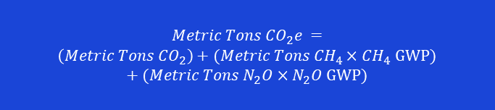
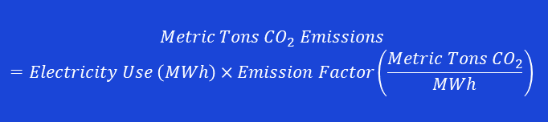
Calculating GHG Emissions
GHG emissions are measured in mass of carbon dioxide equivalents (CO₂e)
Emission Factors:
Electricity
  eGRID2020 (US EPA)
  International Electricity Emission Factors by Country (IEA)
Combustion
  Emission Factor Hub 2022 (US EPA)
  Guidelines for National Greenhouse Gas Inventories (IPCC)
Global Warming Potentials (GWPs):
Compares amount of heat trapped by a given mass of a GHG to amount of heat trapped by similar mass of CO₂
  Converts mass of various gases to mass of CO₂e
  Recommend using 100-year GWPs from IPCC Fourth Assessment Report (AR5)
$$Metric Tons{ CO}_{2} Emissions=Electricity Use \left(MWh\right)×Emission Factor\left(\frac{Metric Tons {CO}_{2}}{MWh}\right)$$
$$Metric Tons{ CO}_{2}e =$$
$\left(Metric Tons {CO}_{2}\right)+(Metric Tons {CH}_{4}×{CH}_{4}$ GWP) $+(Metric Tons N_{2}O×N_{2}O$ GWP)

Slide 25
GHG Emissions Calculation Resources and Tools
Calculating GHG emissions is a multi-step process; many tools can help to develop your GHG inventory.
GHG Protocol standards and guidance
  Guidance to companies preparing a corporate GHG emissions inventory
  Corporate Accounting and Reporting Standard and Scope 2 Guidance
  Corporate Value Chain (Scope 3) Standard and Technical Calculation Guidance
EPA's Center for Corporate Climate Leadership
  Resources for companies seeking to measure and manage GHG emissions
  Simplified GHG Emissions Calculator: tool to help small business and low emitter companies calculate annual GHG emissions

Slide 26
GHG Calculation and CDP Reporting
Ojas Adhir

Slide 27
Poll the Audience
GHG Accounting 101: Scope 1 and 2
Has your company reported Scope 1 and 2 emissions through CDP before?
  Please type your answer into the chat box

Slide 28






Target Questions:
Greenhouse Gas Emissions Data & Energy Usage
2022 MODULES
C0 Introduction
C1 Governance
C2 Risks and opportunities
C3 Business strategy
C4 Targets and performance
C5 Emissions methodology
C6 Emissions data
C7 Emissions breakdown
C8 Energy
C9 Additional metrics
C10 Verification
C11 Carbon pricing
C12 Engagement
C15 Biodiversity
C16 Signoff
SC Supply Chain
Scope 1 – Greenhouse gases that your company emits (C6.1)*
Company Facilities
Company Vehicles
Scope 2 – Greenhouse gases that others emit due to your energy use (C6.2 & C6.3)
Purchased electricity, steam,
heating & cooling, for own use
Scope 3 – Everything else (C6.5)
Supplier emissions
Product use
Employee commuting
*We ask if you already have calculated emissions for 2021 you report them in addition to your 2022 emissions in CDP questions C6.1, 6.3 and 6.5
Notes:
The first part of GHG emissions is disclosing scope 1 emissions as part of C6.1. This includes energy used to generate heat for facilities.
Scope 1 emissions might include emissions from a hot water heater for an office building that’s powered by natural gas, or mobile combustion from travel in company-owned cars.
As a reminder, Scope 1 emissions are direct GHG emissions, 2 and 3 are Indirect emissions
Scope 1 emissions might include emissions from a hot water heater for an office building that’s powered by natural gas, or mobile combustion from travel in company-owned cars
Scope 2 emissions come from the purchase of utilities like electricity, steam, heat, and cooling
Scope 3 emissions are all remaining indirect emissions from an organization’s value chain, such as emissions from the purchased products and services, employee commuting, business travel, and others. Scope 3 emissions are organized into Upstream and Downstream

Slide 29
Calculate GHG Emissions – Scope 1 (C6.1)
Example: An organization purchased 10,000 million mmBTU of natural gas in the reporting year. Emissions calculations for the fuel use are as follows:
Calculate Emissions
Apply GWP to convert to CO2e
Sum
10000 mmBTU x 0.05306 (metric tons CO₂/mmBTU) = 530.6 mt CO₂
CO2
530.6 mtCO2 x 1 = 530.6 mtCO₂e
530.6 + 0.28 + 0.265 = 531.145 mt CO₂e
10000 mmBTU x 0.000001 (metric tons CH4/mmBTU) = 0.01 metric tons CH₄
0.01 mtCH4 x 28 = 0.28 mtCO₂e
CH4
This represents total Scope 1 emissions related to the organization's natural gas use
10000 mmBTU x 0.0000001 (metric tons N2O/mmBTU) = 0.001 metric tons N₂O
N2O
0.001 mtN2O x 265 = 0.265 mtCO₂e
Emission factor source: Emission Factor Hub 2022 (US EPA)
Notes:
WSP
In this example, an organization purchased 10,000 mmBTU of natural gas in the reporting year, which it could use to generate heat and to run equipment. This connects to CDP question C6.1
First we calculate the mass of CO2, CH4, and N2O separately, using publicly available emission factors. The emission factor used here is the US factor for natural gas combustion, and it can be found at the US EPA link at the bottom of this slide. This emission factor applies to all natural gas burned within the US. Please use the international factor for global locations.
Next, we convert these gases to CO2 equivalents using the global warming potentials found at the US EPA link at the bottom of this slide. The GWPs apply to every country.
Finally, we sum the CO2 equivalents to get a single total value
Keep in mind
We also ask that for this upcoming CDP year, when answering this question, you also include your 2021 total emissions as that is Corning base year. You will see an option in a dropdown to include previous year emissions

Slide 30
Target Questions:
Greenhouse Gas Emissions Data & Energy Usage
2022 MODULES
C0 Introduction
C1 Governance
C2 Risks and opportunities
C3 Business strategy
C4 Targets and performance
C5 Emissions methodology
C6 Emissions data
C7 Emissions breakdown
C8 Energy
C9 Additional metrics
C10 Verification
C11 Carbon pricing
C12 Engagement
C15 Biodiversity
C16 Signoff
SC Supply Chain
Scope 1 – Greenhouse gases that your company emits (C6.1)
Company Facilities
Company Vehicles
Scope 2* – Greenhouse gases that others emit due to your energy use (C6.2 & C6.3)
Purchased electricity, steam,
heating & cooling, for own use
Scope 3 – Everything else (C6.5)
Supplier emissions
Product use
Employee commuting
*We ask if you already have calculated emissions for 2021 you report them in addition to your 2022 emissions in CDP questions C6.1, 6.3 and 6.5
Notes:
Summary of GHG q
Scope 2 emissions come from the purchase of utilities like electricity, steam, heat, and cooling
Moving to Scope 2 emissions from Purchased Electricity, the two Methods must first be factored:
Based on guidance issued in 2015, organizations are now required to report two Scope 2 electricity totals - location-based and market-based
These are listed in the slides below.
Firstly, we calculate the location based emissions which uses average emission factors for the electricity grids that provide electricity to your facility.
Secondly, we use the market based total which considers contractual arrangements under which the reporting organization procures power from specific suppliers or sources. If you don’t have specific factors, then you can use the grid averages, in which case, your grid based and market based would be exactly the same.
As a reminder, we also ask that for this upcoming CDP year, when answering this question, you also include your 2021 total emissions as that is Corning base year. You will see an option in a dropdown to include previous year emissions

Slide 31
Calculate GHG Emissions – Scope 2 – Location Based (C6.3))
Example: An organization with facilities in Mexico purchased 500,000 MWh of electricity in the reporting year. Emissions calculations for the electricity purchases are as follows:
Calculate Emissions
Apply GWP to convert to CO2e
Sum
500000 MWh x 0.45 (metric ton CO2/MWh) = 225000 mt CO₂
CO2
225000 mtCO2 x 1 = 225000 mtCO₂e
225000 + 252 + 598.9= 225,850.9 mt CO2e
500000 MWh x 0.000018 (metric ton CH4/MWh) = 9 mt CH₄
9 mtCH4 x 28 = 252 mtCO₂e
CH4
This represents total Scope 2 Location based emissions related to the organization’s electricity use
500000 MWh x 0.00000454 (metric ton N2O /MWh) = 2.26 mt N₂O
N2O
2.26 mtN2O x 265 = 598.9 mtCO₂e
Emission factor source: International Electricity Emission Factors by Country (IEA); Emission Factor Hub 2022 (US EPA)
Notes:
WSP
In this example, an organization purchased 500000 Mwh in the reporting year, which it could use to generate electricity. This connects to CDP question C6.3
First we calculate the mass of CO2, CH4, and N2O separately, using publicly available emission factors. The emission factor used here is a grid factor for Mexico, and it can be found at the IEA link at the bottom of this slide. .
Next, we convert these gases to CO2 equivalents using the global warming potentials found at the US EPA link at the bottom of this slide. The GWPs apply to every country. You will notice the GWPs are the same for both scope 1 & 2.
Finally, we sum the CO2 equivalents to get a single total value
As a note, please make sure your emission factor and energy value have the correct units – be sure to apply a conversion factor if necessary. For example, if that was 500,000 kWh. You will need to convert it to MWh before calculating total emissions

Slide 32
Calculate GHG Emissions – Scope 2 – Market Based (C6.3)
Example: An organization with facilities in Mexico purchased 500,000 MWh of electricity in the reporting year. However, they purchase RECs for half their energy use. Emissions calculations for the electricity purchases are as follows:
Calculate Emissions
Apply GWP to convert to CO2e
Sum
250000 MWh x 0.45 (metric ton CO2/MWh) = 112500 mt CO₂
CO2
225000 mtCO2 x 1 = 112500 mtCO₂e
115000 + 112.5 + 336.74= 115449.24 mtCO₂e
250000 MWh x 0.000018 (metric ton CH4/MWh) = 4.5 mt CH₄
4.5 mtCH4 x 28 = 112.5 mtCO₂e
CH4
This represents total Scope 2 market-based emissions related to the organization’s electricity use
250000 MWh x 0.00000454 (metric ton N2O /MWh) = 1.13 mt N₂O
N2O
1.13 mtN2O x 265 = 336.74 mtCO₂e
Emission factor source: International Electricity Emission Factors by Country (IEA); Emission Factor Hub 2022 (US EPA)
Notes:
WSP
ON the previous slide we calculated location-based emissions
Here’s an example to show how to calculate market-based emissions.
Based on the example we looked at earlier, let’s say the organization decides to purchase Renewable Electricity Certificates or RECs for half of their electricity use
The location-based emissions for the organization would remain the same, because they are still purchasing 250,000 MWh of grid electricity.
Market-based emissions, however, are calculated differently with the purchase of RECs for half the electricity use. We would apply an emission factor of zero to the RECs, and then calculate 250,000 mwh using the emission factor.
Note that location and market-based emissions are reported separately and never summed together

Slide 33
Target Questions:
Greenhouse Gas Emissions Data & Energy Usage
2022 MODULES
C0 Introduction
C1 Governance
C2 Risks and opportunities
C3 Business strategy
C4 Targets and performance
C5 Emissions methodology
C6 Emissions data
C7 Emissions breakdown
C8 Energy
C9 Additional metrics
C10 Verification
C11 Carbon pricing
C12 Engagement
C15 Biodiversity
C16 Signoff
SC Supply Chain
Scope 1 – Greenhouse gases that your company emits (C6.1)
Company Facilities
Company Vehicles
Scope 2 – Greenhouse gases that others emit due to your energy use (C6.2 & C6.3)
Purchased electricity, steam,
heating & cooling, for own use
Scope 3 – Everything else (C6.5)
Supplier emissions
Product use
Employee commuting
*We ask if you already have calculated emissions for 2021 you report them in addition to your 2022 emissions in CDP questions C6.1, 6.3 and 6.5
Notes:
Scope 3 emissions are all remaining indirect emissions from an organization’s value chain, such as emissions from the purchased products and services, employee commuting, business travel, and others. Scope 3 emissions are organized into Upstream and Downstream. We will go into more detail on how to calculate these categories in our scope 3 webinar next week

Slide 34
Calculating GHG Intensity C6.10
Many organizations look at their GHG intensity to see their carbon intensity by revenue. To calculate GHG intensity, divide the sum of scope 1 & 2 emissions by total revenue.
It is important to report the intensity in units of revenue in the currency reported. You should not be dividing your emissions by multiples of a currency.
For example, if your total scope 1 & 2 emissions is 500 mt CO₂e and your revenue is $25 million. You should divide it as 500 25,000,000 = 0.00002 mt CO₂e/ USD
(not 500/25 or 500/2500 – it should be in single units)
As a rule of thumb, expect GHG intensity per US Dollar to be less than 0.01 mtCO₂e / USD.

Slide 35
Calculating total energy use – 8.2a
2022 MODULES
C0 Introduction
C1 Governance
C2 Risks and opportunities
C3 Business strategy
C4 Targets and performance
C5 Emissions methodology
C6 Emissions data
C7 Emissions breakdown
C8 Energy
C9 Additional metrics
C10 Verification
C11 Carbon pricing
C12 Engagement
C15 Biodiversity
C16 Signoff
SC Supply Chain
Question C8.2a asks you to report the amount of each source of energy used in the reporting year. There are four rows:
Row 1 is for consumption of fuel (excluding feedstock)
Row 2 is for consumption of purchased or acquired electricity
Row 3 is for consumption of purchased or acquired heat
Row 4 is for consumption of purchased or acquired steam
Row 5 is for consumption of purchased or acquired cooling
Row 6 is for consumption of self-generated nonfuel renewable energy
Row 7 is the total energy of the 6 rows above
Instructions: Enter the total MWh of each source used, separating renewable energy from traditional energy. If you do not use a given source of energy, enter 0 (zero) – there should be no blank fields. A blank field does not equate to zero and will be considered incomplete.
Notes:
The aim of this question is disclose the different types of energy consumption across the organization. Please keep in mind that no row should be blank – it should be zero if you do have this time of energy
C8.2 is the other commonly challenging question that often requires follow-up amendments
Here selecting the correct yes/no option is critical as it determines what supporting energy use data will be collected in C8.2a
For “Consumption of purchased or acquired electricity”:
Select “Yes” if your company purchased electricity delivered by a 3rd party (e.g., utility).
You should only select “No” in this row if you generate ALL of your electricity for all facilities globally from self-generated electricity
And for “Generation of electricity, heat, steam, or cooling”:
Select “Yes” if your company generated renewable electricity from an installation that is owned by your organization either on-site or off-site. Only owned renewables are included.
Select “No” if your company did not generate renewable electricity
8.2a then asks to report the amount of each source of energy used in the reporting year
When completing the question, please do not leave any fields blank
And all data must be entered in MWh
If you do not use a given source of energy, please enter zero as leaving the field blank makes it unclear whether the field was accidentally skipped

Slide 36
Verification C10
Calculating GHG Emissions
Engage Auditing Services
Publish results
Calculate Scope 1, 2 & 3 emissions
Identify a verification provider
Improve inventory data quality & accuracy
It is important to verify your greenhouse gas emissions data and other critical key environmental metrics.
  Verification provides credibility of reported data to internal and external stakeholders
Your company can reach out to professional services firms that provide assurance and auditing services to verify your inventory
Please refer to the CDP Guidance Page for additional resources about the assurance process
Verification aligns your inventory with industry standards that are recognized globally

Slide 37
Calculating SC1.1 – Allocating Emissions
Example: An organization has a total scope 1 emissions of 300 mt CO2e & scope 2 emissions 2400 mt CO2e Corning purchases $5 million from an organization whose total revenue is $30 million dollars
Allocated Scope 1 Emissions = 5,000,000/30,000,000 X 300 mt CO₂e = 50 mt CO₂e
Allocated Scope 2 Emissions = 5,000,000/30,000,000 X 2400 mt CO₂e = 400 mt CO₂e
Formula for allocating emissions to Corning based on revenue
Allocated GHG Emissions | = | Revenue of products/services purchased by Corning | x | Total GHG Emissions for Scope 1 or Scope 2
 |  | Total revenue of products/services produced
Notes:
Here is an example of how to allocate your emissions by revenue. This is the standard starting point for most organizations, there are more advanced allocation methods such as facility level. However, today we will only focus on this standard method. h scope.
Essentially, the calculation is the revenue of products and/or service purchased by Corning divided by your total revenue of products and/or services that you produce and then multiply this number by the total GHG emissions for either scope 1 or 2 - depending on which scope you are calculating at the time. Again, please repeat this calculation for each scope so you should have multiple response line within this question.

Slide 38
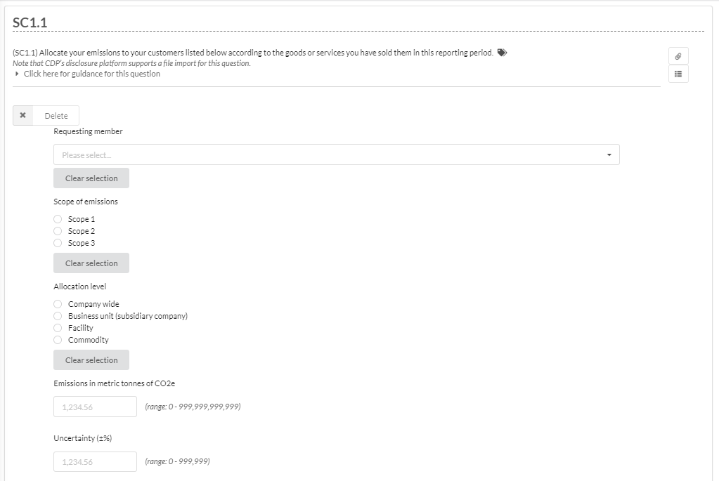
Allocating Emissions by Revenue for SC1.1
Step 1: Select Corning from dropdown.
Step 2: Choose which scope of emissions you are reporting. Please provide emissions for each scope on separate rows. So if you only report scope 1 & 2, you should have two rows.
Step 3: Select Allocation level
Note: if allocating by subsidiary, facility, or commodity, provide emissions for each in separate rows.
Step 4: Provide allocated emissions in metric tones of CO₂e
Step 5: Provide an uncertainty percentage (how uncertain are you in the accuracy of the allocated emissions).
Notes:
The Uncertainty % should be tracked YoY with the aim of uncertainty decreasing each year

Slide 39
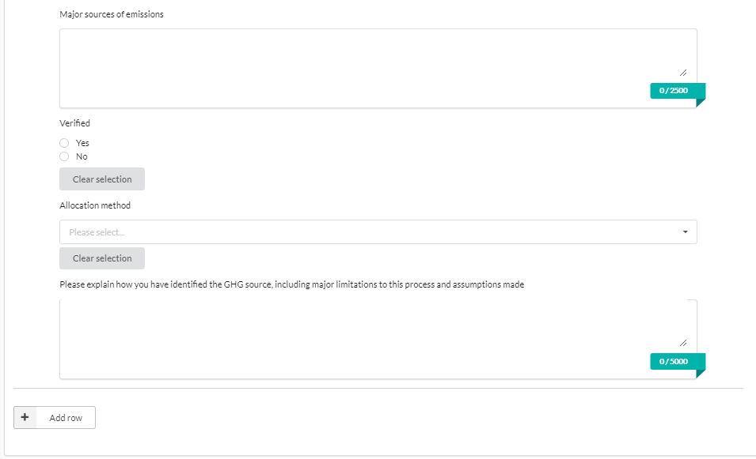
Allocating Emissions by Revenue for SC1.1
Step 6: Provide the sources of emissions for which you have provided an emissions figure. For example, emissions from machinery used in production (scope 1).
Step 7:Was this allocation verified by an independent third-party organization?
Step 8: Select the Allocation method from the dropdown. For example, allocation based on the market value of products purchased.
Step 9: Provide an explanation about your methodology for collecting and calculating emissions.
Step 10: Add another row to provide emission data for an additional scope of emissions.

Slide 40
Next Steps and Resources

Slide 41
GHG 101: Scopes 1 & 2
Next Steps
Look forward to the upcoming GHG 101: Scope 3 Training on May 11th
Socialize new expectations of Corning suppliers
  Disclose scope 1, 2 and 3 greenhouse gas (GHG) emissions data through CDP Supply Chain.
    We ask if you already have calculated emissions for 2021 you report them in addition to your 2022 emissions in CDP questions C6.1, 6.3 and 6.5
  Provide independent or third-party assurance of disclosed emissions
If you are completing your GHG Inventory for the first time, please reference the resources provided, including this Simplified GHG Emissions Calculator which is a tool to help suppliers calculate annual GHG emissions

Slide 42
GHG Emissions Calculation Resources and Tools
Calculating GHG emissions is a multi-step process; many tools can help to develop your GHG inventory.
GHG Protocol standards and guidance
  Guidance to companies preparing a corporate GHG emissions inventory
  Corporate Accounting and Reporting Standard and Scope 2 Guidance
  Corporate Value Chain (Scope 3) Standard and Technical Calculation Guidance
EPA's Center for Corporate Climate Leadership
  Resources for companies seeking to measure and manage GHG emissions
  Simplified GHG Emissions Calculator: tool to help small business and low emitter companies calculate annual GHG emissions

Slide 43
Thank you for your continued support contact us at gsmsustainability@corning.com

Slide 44
Questions

